Slide 1
Numerical Computation Lec 3
By
Asst. Prof. Syed Shujaat Hussain

Slide 2
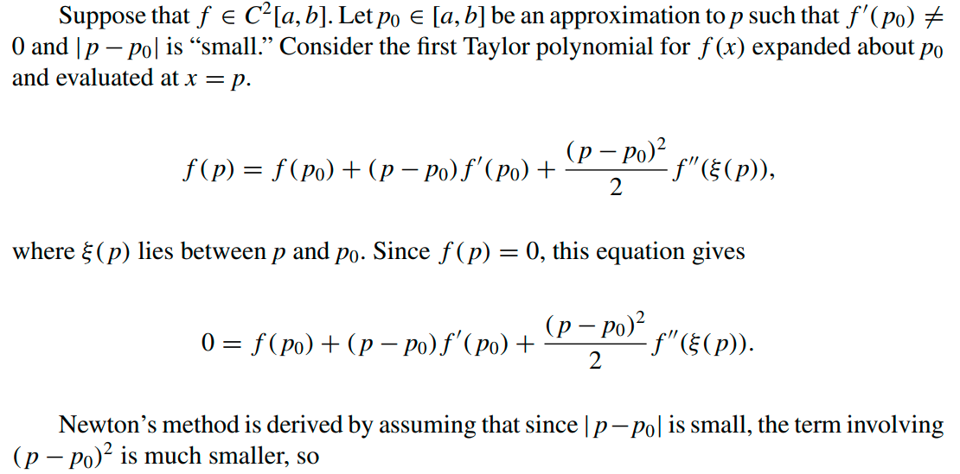
Newton’s (or the Newton-Raphson) method

Slide 3
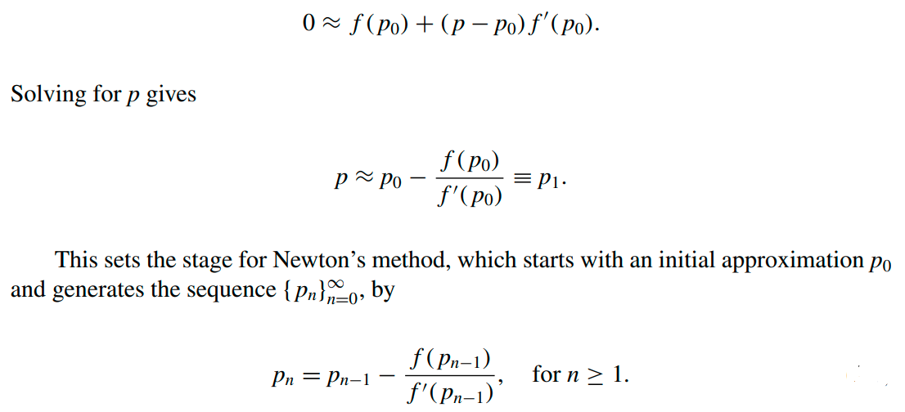
It is clear from above Equation that Newton’s method cannot be continued if f ( p_{n−1}) = 0 for some n. In fact, we will see that the method is most effective when f is bounded away from zero near p.

Slide 4
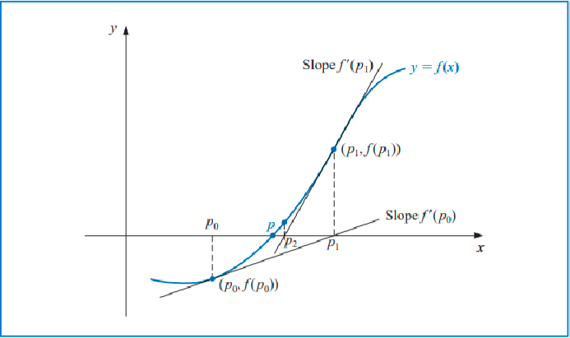
Figure illustrates how the approximations are obtained using successive tangents. Starting with the initial approximation p₀, the approximation p₁ is the x-intercept of the tangent line to the graph of f at ( p₀, f ( p₀)). The approximation p₂ is the x-intercept of the tangent line to the graph of f at ( p₁, f ( p₁)) and so on.

Slide 5
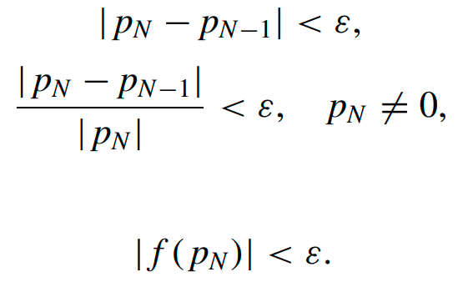

The stopping-technique inequalities
select a tolerance ε > 0, and construct p1, ... $p_{N}$ until

Slide 6
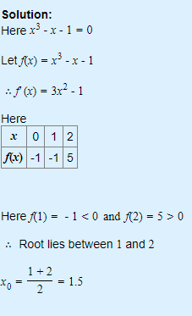
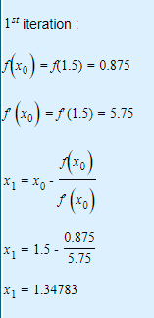
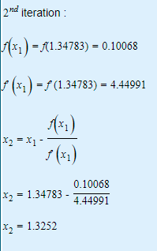
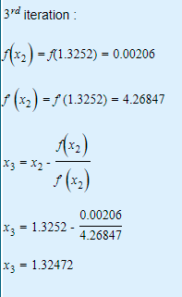
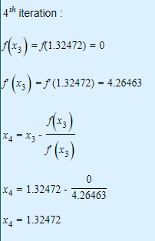
Example : Find a root of an equation f(x)=x³-x-1 using Newton Raphson method

Slide 7
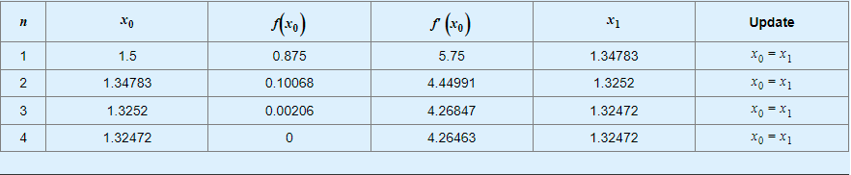
Iteration Result from Newton’s Method
Point Function Derivative New Point
Note: Root bracketing is not guaranteed for Newton’s method.

Slide 8

Class Activity
Q Use Newton’s Method for finding the root of
$$f\left(x\right)=4x−Cosx −1$$
With starting initial guess x= 2

Slide 9
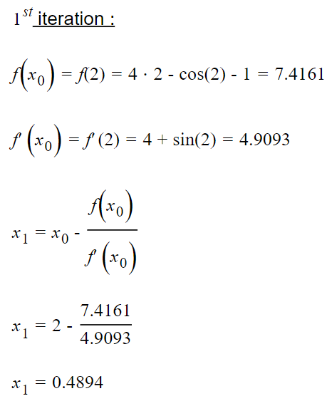
Iteration

Slide 10
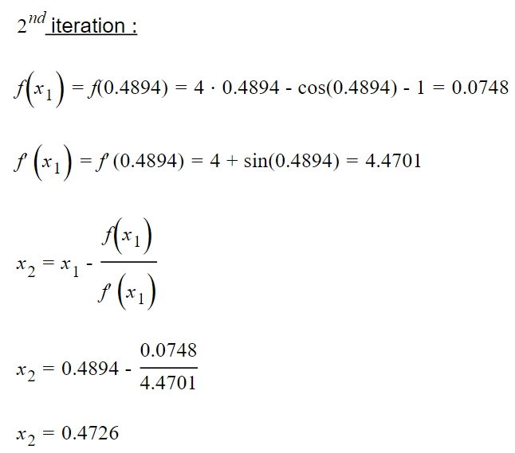
Iterations

Slide 11
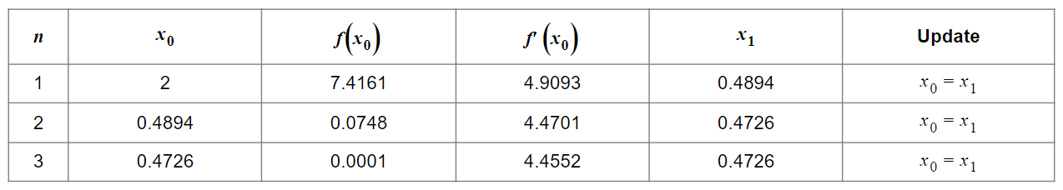
Solution
Root is 0.4726
Point Function Derivative New Point

Slide 12
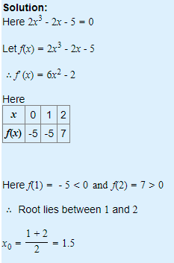
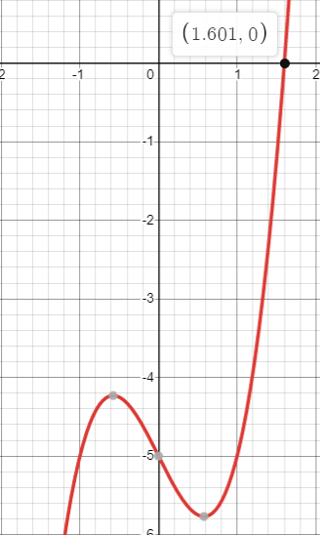
Class Activity Q : Find a root of an equation f(x)=2x³-2x-5 using Newton Raphson method

Slide 13
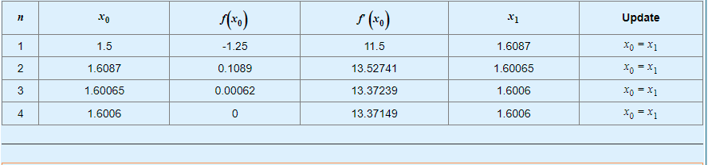
Solution : Iteration Result from Newton’s Method
Point Function Derivative New Point

Slide 14

Class Activity
Q Use Newton’s Method for finding the root of
$$f\left(x\right)= 2Sinx−\frac{e^{x}}{4} −1$$
With starting initial guess x= 1.2

Slide 15
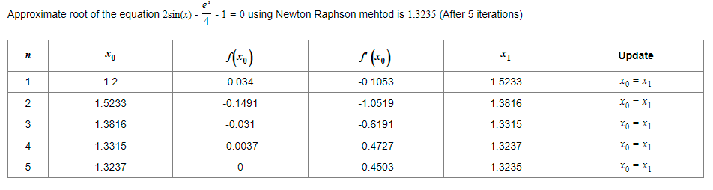
Solution
Point Function Derivative New Point

Slide 16

Test your ability!
Q Use Newton’s method to find the root of $\tan{x−2x=0}$.
Using the initial guess x= 1.4

Slide 17
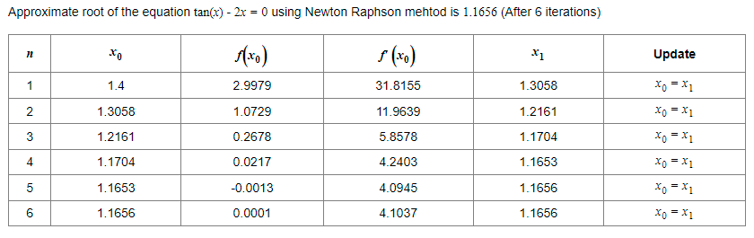
Solution
Point Function Derivative New Point

Slide 18
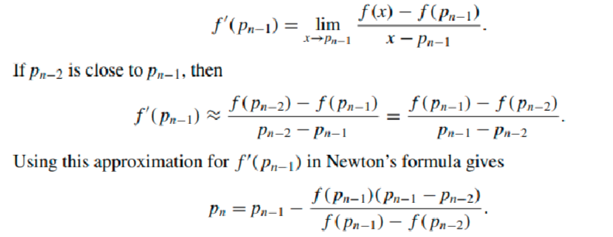
The Secant Method
By definition,
This technique is called the Secant method

Slide 19
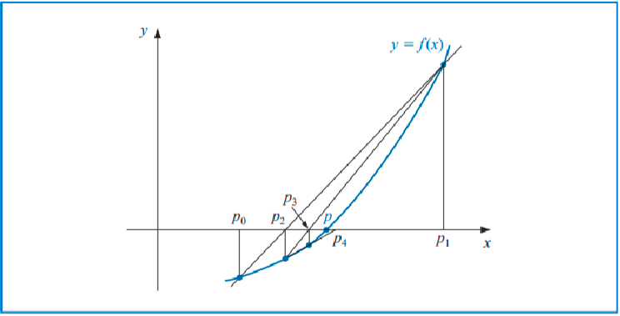
Starting with the two initial approximations p0 and p1, the approximation p2 is the x-intercept of the line joining ( p0, f ( p0)) and ( p1, f ( p1)). The approximation p3 is the x-intercept of the line joining ( p1, f ( p1)) and ( p2, f ( p2)), and so on. Note that only one function evaluation is needed per step for the Secant method after p2 has been determined.

Slide 20
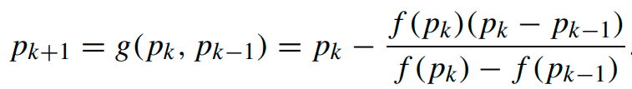
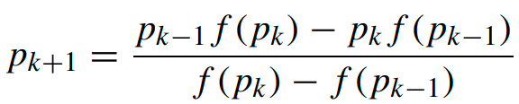
Class Activity
Q The general term in Secant method is given by the two point iteration formula
Show that the above formula is algebraically equivalent to

Slide 21
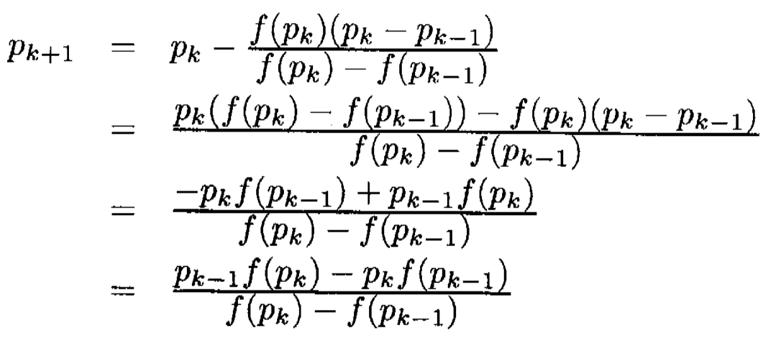
Solution
Note: For the purpose of simplicity lets take ${a=P}_{k−1 } b=P_{k} c=P_{k+1}$
Task: Re write the formula with above notation.

Slide 22


Secant Method Formula
$$c = \frac{a f\left(b\right)−b f(a)}{f\left(b\right)−f(a)}$$
OR
$$x2 = \frac{x0f\left(x1\right)−x1f(x0)}{f\left(x1\right)−f(x0)}$$

Slide 23
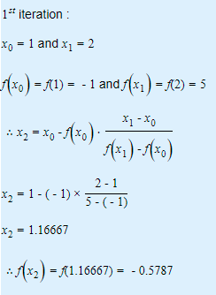
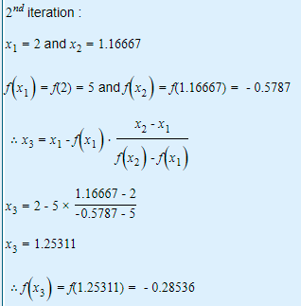
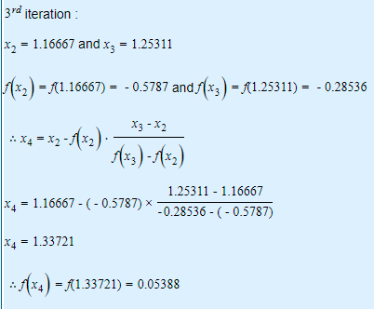
Example: Find a root of an equation f(x)=x³-x-1 using Secant method

Slide 24
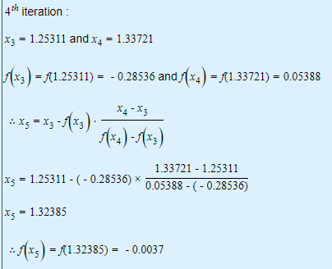
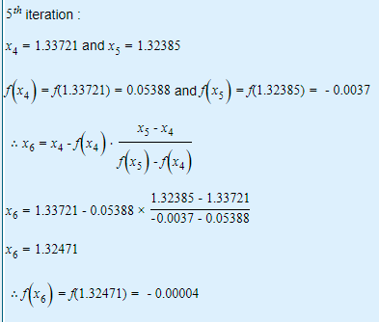
Iteration continue..

Slide 25
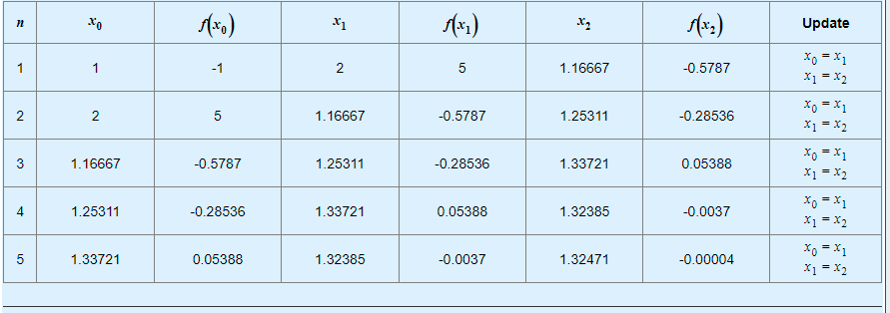
Iteration Result from Secant Method
Note: Root bracketing is not guaranteed for Secant method.

Slide 26
Class Activity Q : Find a root of an equation f(x)=2x³-2x-5 using Secant method

Slide 27
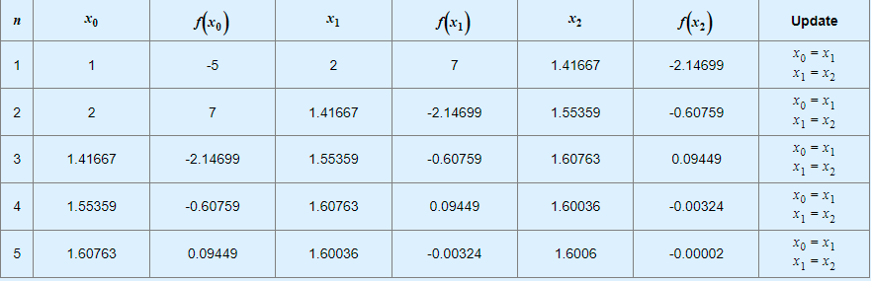
Iteration Result from Secant Method

Slide 28
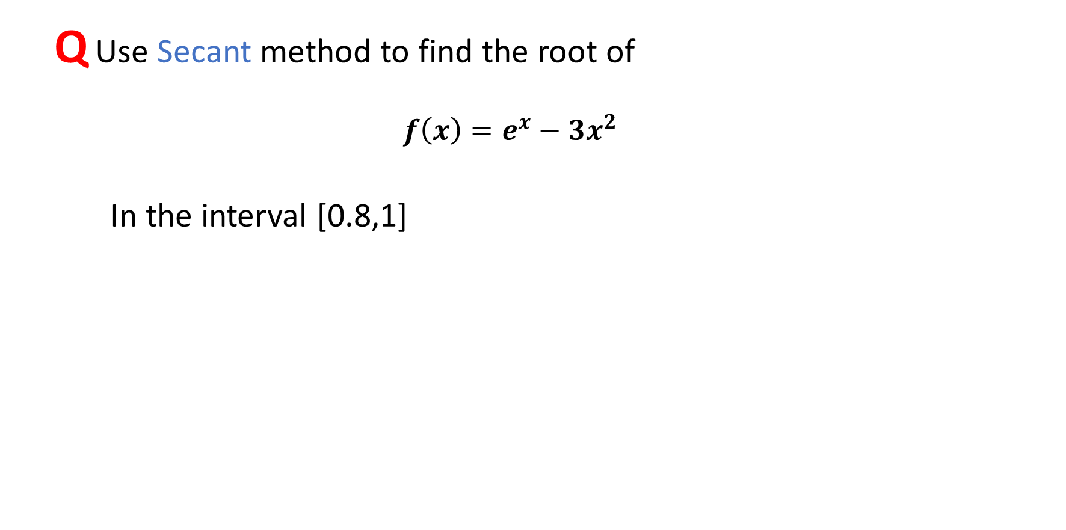
Class Activity
Q Use Secant method to find the root of
$$f\left(x\right)=e^{x}−3x^{2}$$
In the interval [0.8,1]

Slide 29
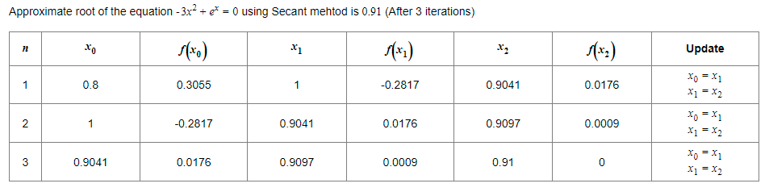
Solution

Slide 30

Test your ability!
Q Use Secant Method for finding the root of
$sinx−e^{−x}=0$
In the interval [0,1]

Slide 31
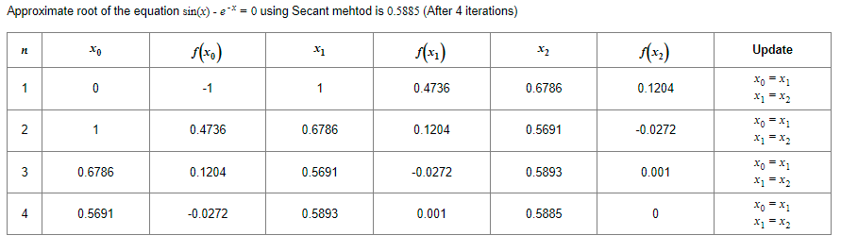
Solution

